Slide 1

RESEARCH METHODology
Course Code RMT06504
Compulsory Generic Core Course
4 Credit
Learning Hours- 4 hours per week
Cumulative Internal Examinations (CIE)- 40 Marks
Semester End Examination (SEE) – 60 marks
Notes:
‹#›

Slide 2
Introduction to Research Methodology and Design
Chapter 1

Slide 3
INTRODUCTION TO RESEARCH
Research is the process of finding solutions to a problem after a thorough study and analysis of the situational factors.
Notes:
‹#›

Slide 4
OBJECTIVES OF RESEARCH
To gain familiarity with a phenomenon or to achieve new insights into it. (exploratory or formulative research studies)
To portray accurately the characteristics of a particular individual, situation or a group (descriptive research studies)
To determine the frequency with which something occurs or with which it is associated with something else (diagnostic research studies)
To test a hypothesis of a causal relationship between variables (hypothesis-testing research studies).
Notes:
‹#›

Slide 5
MOTIVATION IN RESEARCH
Desire to get a research degree along with its consequential benefits;
Desire to face the challenge in solving the unsolved problems, i.e., concern over practical problems initiates research;
Desire to get intellectual joy of doing some creative work;
Desire to be of service to society;
Desire to get respectability.
Notes:
‹#›

Slide 6
WHAT IS BUSINESS RESEARCH?
Research provides the needed information that guides managers to make informed decisions to successfully deal with problems.
The information provided could be the result of a careful analysis of data gathered firsthand or of data that are already available (in the company).
Notes:
‹#›

Slide 7

Information
Reduces
Uncertainty
I don’t know
if we
should
offer on-site
child care?
Notes:
‹#›

Slide 8
DEFINITION OF RESEARCH
According to C.R. Kothari, research is a systematic investigation that aims to discover and interpret facts to gain new insights and accurate descriptions of phenomena.
It can also be defined as an original contribution to existing knowledge that helps develop it.
Notes:
‹#›

Slide 9
TYPES OF RESEARCH.
1.Applied research
Is to solve a current problem faced by the manager in the work setting, demanding a timely solution.
2.Basic research (fundamental, pure)
Is to generate a body of knowledge by trying to comprehend how certain problems that occur in organizations can be solved.
The findings of such research contribute to the building of knowledge in the various functional areas of business.
Notes:
‹#›

Slide 10
BASIC RESEARCH
Attempts to expand the limits of knowledge.
Not directly involved in the solution to a pragmatic problem.
Notes:
‹#›

Slide 11
BASIC RESEARCH EXAMPLE
Is executive success correlated with high need for achievement?
Are members of highly cohesive work groups more satisfied than members of less cohesive work groups?
Do consumers experience cognitive dissonance in low-involvement situations?
Notes:
‹#›

Slide 12
APPLIED RESEARCH
Conducted when a decision must be made about a specific real-life problem
Notes:
‹#›

Slide 13
APPLIED RESEARCH EXAMPLES
Should McDonalds add Italian pasta dinners to its menu?
Business research told McDonald’s it should not?
Should Procter & Gamble add a high-priced home teeth bleaching kit to its product line?
Research showed Crest Whitestrips would sell well at a retail price of $44
Notes:
‹#›

Slide 14
Research Methods vs. Methodology
Definition:
Research Methods: Specific techniques and procedures used to collect and analyze data (e.g., surveys, experiments).
Research Methodology: The overarching strategy and rationale guiding the choice of research methods and their application.
Focus:
Research Methods: Concerned with the "how" of conducting research—practical steps like data collection and analysis.
Research Methodology: Focuses on the "why"—the reasoning behind choosing specific methods and the underlying principles.
Scope:
Research Methods: Narrower in scope, dealing with the actual execution of research tasks.
Research Methodology: Broader in scope, encompassing the entire research process, including theoretical frameworks, research design, and the justification for using certain methods.

Slide 15
Significance of Research Methodology
Guides Research Direction: Research methodology helps researchers define the path they need to follow to achieve their research objectives. It ensures that the research stays focused and that the steps taken are appropriate to address the research questions.
Ensures Validity and Reliability: A well-structured research methodology ensures that the results obtained are valid (accurately represent what they are supposed to measure) and reliable (consistent when repeated under the same conditions).
Facilitates Data Collection and Analysis: It provides clear guidelines on how data should be collected, what tools and techniques should be used, and how data should be analyzed to derive meaningful conclusions.

Slide 16
Enables Replication: By documenting the research methodology in detail, other researchers can replicate the study to verify results or build on the original research, contributing to the body of knowledge in the field.
Enhances Objectivity: A well-defined methodology reduces bias in the research process by ensuring that data collection and analysis are based on objective criteria, leading to more credible results.
Improves Decision-Making: Research methodology helps in the interpretation of data and results, enabling researchers to make informed decisions and draw accurate conclusions that can be applied in real-world scenarios.
Supports Ethical Research: Methodology often includes ethical considerations, ensuring that the research is conducted in a manner that respects the rights and dignity of participants, which is crucial in maintaining the integrity of the research.

Slide 17
The research process
1 Observation
2 Data gathering
3 Problem definition
4 Theoretical framework (variables identified)
5 Hypotheses
6 Research design
7 Data collection, analysis, interpretation
8 Deduction
9 Report writing
10 Report presentation
11 Managerial decision making

Slide 18
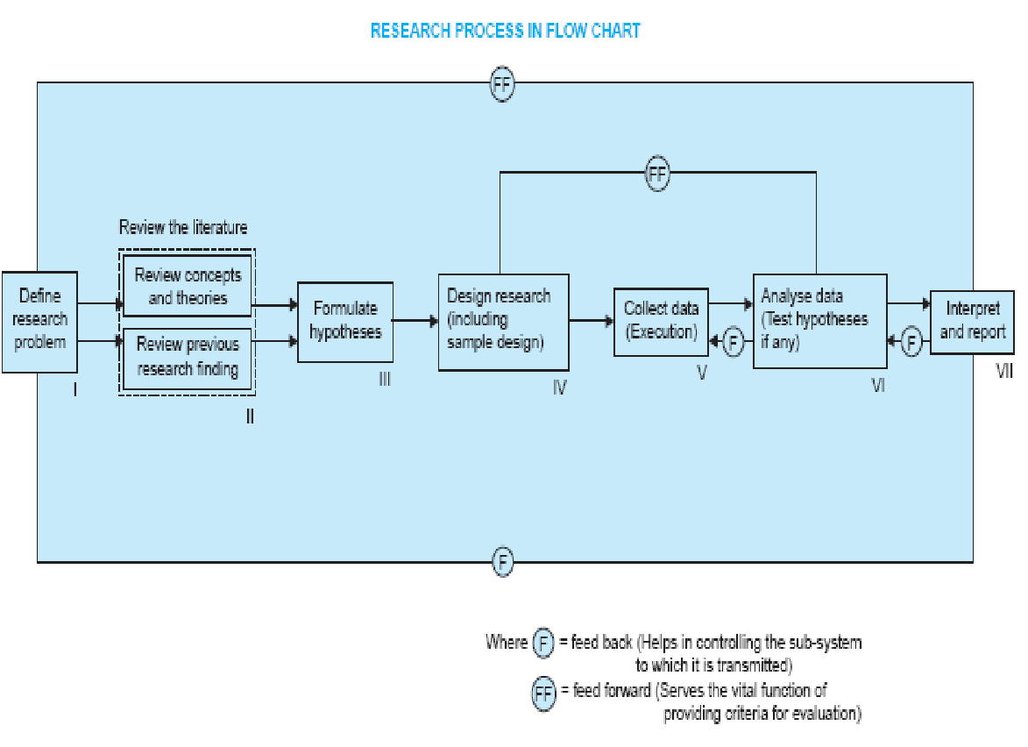
Notes:
‹#›

Slide 19
Research Problem Definition: Selecting and Defining the Problem

Slide 20
Introduction to Research Problem
A research problem is the initial step in the research process.
It guides the direction of the study.
It involves identifying a gap in knowledge or a pressing issue that needs investigation.

Slide 21
Criteria for Selecting a Research Problem
Relevance: Should address a current or significant issue.
Feasibility: Should be manageable with available resources (time, money, data, etc.).
Novelty: Should contribute new insights to the existing body of knowledge.
Interest and Passion: Researchers must be genuinely interested in the problem.
Ethical Considerations: Should align with ethical standards.

Slide 22
Sources for Identifying a Research Problem
Literature Review: Gaps in existing research.
Practical Problems: Issues faced in professional practice.
Theoretical Frameworks: Unanswered questions in theories.
Personal Experience: Observations or challenges in everyday life.
Discussion with Experts: Consulting professionals or academics.

Slide 23
Steps in Selecting a Research Problem
Explore the Broad Subject Area: Identify the field of interest.
Narrow Down to a Specific Issue: Focus on a manageable aspect.
Review the Literature: Understand existing studies and gaps.
Assess Feasibility: Consider resources, scope, and time.
Formulate Initial Questions: Begin with general questions before refinement.

Slide 24
Defining the Research Problem
Clear articulation of the problem.
Should be concise and precise.
Example: "What is the impact of social media on consumer buying behavior in the retail industry?"

Slide 25
Steps in Defining the Problem
State the Problem Clearly: In one or two sentences.
Specify Key Variables: Identify dependent and independent variables.
Contextualize the Problem: Relate it to the broader research area.
Identify the Research Objectives: Outline the purpose of the study.

Slide 26
Example: Defining a Research Problem
Topic: The impact of digital marketing on small businesses.
Research Problem: "How does the adoption of digital marketing strategies influence the profitability and growth of small businesses in urban areas?"

Slide 27
Activity for Students
Select a broad topic of interest.
Narrow down to a specific research problem.
Write a clear problem statement in 2-3 sentences.

Slide 28
Question to be asked | Steps to be taken | Elements of the step
Who will collect and when? | Work plan | Personnel, manpower Timetable
How will be monitored? How the research findings will be used? | Research administration plan | -Administration - Monitoring Identification of potential users
What and how much resources are needed? Who will provide the resources ? | Budget Funding Organizations | 3 Ms: Man, materials, money Fund collection, fund raising
Who will submit? How to submit? Where to submit? | Proposal preparation Proposal presentation Appropriate authority | Researcher Proposal Presentation techniques

Slide 29
RESEARCH QUESTION
A research question is the hypothesis of choice that best states the objective of the research study.
the choice hypothesis that best states the objective of the research; the answer to this question would provide the manager with the desired information necessary to make a decision with respect to the management dilemma.

Slide 30
RESEARCH QUESTION
At this stage, a clear picture of the management and research questions begins to emerge
Fine tune the research question
  Examine concepts and constructs
  Break research questions into specific second-and-third-level questions
  Verify hypotheses with quality tests
  Determine what evidence answers the various questions and hypothesis
  Set the scope of your study

Slide 31
Research Question
Fine tune the research question
  Examine concepts and constructs. Are they satisfactorily defined ? Have operational definitions been employed where appropriate ?
  Review the research questions with the intent of breaking them down into specific second-and-third-level questions
  If hypotheses are used, be certain they meet the quality tests mentioned in the preceding chapter.
  Determine what evidence must be collected to answer the various questions and hypothesis
  Set the scope of the study by stating what is not a part of the research question. This will establish a boundary to separate contiguous problems from the primary objective

Slide 32
RESEARCH: PROPOSAL
…is format and detailed statement of intent of the researcher
…..presents and justifies a plan of action and shows the investigation plan

Slide 33
WHAT IS A RESEARCH PROPOSAL?
CONTENT BEYOND SYLLABUS
Various terminologies are used to mean a research proposal depending on why the research is carried out?
Research outline
Synopsis of research
Plan of research
Research/project proposal
Thesis plan
Etc
.. ..a blue print of future activities of a research project
…..some sort of preconceived framework for starting the activities
…..deals with ideas of researcher about what research he/she wants to do, what objectives and methodology he/she has set, how much time and resources are required to complete it, how the research finding are to be reported, and so on.

Slide 34
WHAT IS A RESEARCH PROPOSAL?
CONTENT BEYOND SYLLABUS
…..deals with ideas of researcher about
what researcher he/she wants to do
what objectives and methodology he/she has set
how much time and resources are required to complete it
how the research finding are to be reported
and so on.
..is an individual’s or a research institute's formal offer to produce a product or render service to a client in response to a request from the client
….a work plan, prospectus, outline, and statement of intent ahead.
In short, he/she is proposing a work frame for completing the research

Slide 35
HOW TO WRITE RESEARCH PROPOSAL?
CONTENT BEYOND SYLLABUS
A research proposal is intended to convince others that you have a worthwhile research project and that you have the competence and the work-plan to complete it.
Generally, a research proposal should contain all the key elements involved in the research process and include sufficient information for the readers to evaluate the proposed study.
Regardless of your research area and the methodology you choose, all research proposals must address the following questions:
What you plan to accomplish
why you want to do it and
how you are going to do it.

Slide 36
HOW TO WRITE RESEARCH PROPOSAL?
CONTENT BEYOND SYLLABUS
The proposal should have sufficient information to convince your readers that you have an important research idea, that you have a good grasp of the relevant literature and the major issues, and that your methodology is sound.
Title
It should be concise and descriptive. Often titles are stated in terms of a functional relationship, because such titles clearly indicate the independent and dependent variables. However, if possible, think of an informative but catchy title. An effective title not only pricks the reader's interest, but also predisposes him/her favourably towards the proposal.
Abstract
It is a brief summary of approximately 300 words. It should include the research question, the rationale for the study, the hypothesis (if any), the method and the main findings.

Slide 37
HOW TO WRITE RESEARCH PROPOSAL?
CONTENT BEYOND SYLLABUS
Introduction
The main purpose of the introduction is to provide the necessary background or context for your research problem. How to frame the research problem is perhaps the biggest problem in proposal writing.
However, try to place your research question in the context of either a current "hot" area, or an older area that remains viable. Secondly, you need to provide a brief but appropriate historical backdrop. Thirdly, provide the contemporary context in which your proposed research question occupies the central stage. Finally, identify "key players" and refer to the most relevant and representative publications. In short, try to paint your research question in broad brushes and at the same time bring out its significance.

Slide 38
HOW TO WRITE RESEARCH PROPOSAL?
CONTENT BEYOND SYLLABUS
The introduction generally covers the following elements:
State the research problem, which is often referred to as the purpose of the study
Provide the context and set the stage for your research question in such a way as to show its necessity and importance
Present the rationale of your proposed study and clearly indicate why it is worth doing
Briefly describe the major issues and sub-problems to be addressed by your research.
Identify the key independent and dependent variables of your experiment. Alternatively, specify the phenomenon you want to study
State your hypothesis or theory, if any. For exploratory or phenomenological research, you may not have any hypotheses. (Please do not confuse the hypothesis with the statistical null hypothesis.)
Set the delimitation or boundaries of your proposed research in order to provide a clear focus.
Provide definitions of key concepts. (This is optional.)

Slide 39
HOW TO WRITE RESEARCH PROPOSAL?
Literature Review
most professors prefer a separate section, which allows a more thorough review of the literature
The literature review serves several important functions:
Ensures that you are not "reinventing the wheel“
Gives credits to those who have laid the groundwork for your research
Demonstrates your knowledge of the research problem
Demonstrates your understanding of the theoretical and research issues related to your research question
Shows your ability to critically evaluate relevant literature information
Indicates your ability to integrate and synthesize the existing literature
Provides new theoretical insights or develops a new model as the conceptual framework for your research
Convinces your reader that your proposed research will make a significant and substantial contribution to the literature (i.e., resolving an important theoretical issue or filling a major gap in the literature).

Slide 40
HOW TO WRITE RESEARCH PROPOSAL?
Methods
The Method section is very important because it tells your Research Committee how you plan to tackle your research problem. It will provide your work plan and describe the activities necessary for the completion of your project
The guiding principle for writing the Method section is that it should contain sufficient information for the reader to determine whether methodology is sound
Furthermore, since there are no well-established and widely accepted canons in qualitative analysis, your method section needs to be more elaborate than what is required for traditional quantitative research
More importantly, the data collection process in qualitative research has a far greater impact on the results as compared to quantitative research.

Slide 41
HOW TO WRITE RESEARCH PROPOSAL?
For quantitative studies, the method section typically consists of the following sections:
Design -Is it a questionnaire study or a laboratory experiment? What kind of design do you choose?
Subjects or participants - Who will take part in your study ? What kind of sampling procedure do you use?
Instruments - What kind of measuring instruments or questionnaires do you use? Why do you choose them? Are they valid and reliable?
Procedure - How do you plan to carry out your study? What activities are involved? How long does it take?

Slide 42
HOW TO WRITE RESEARCH PROPOSAL?
Results
Obviously you do not have results at the proposal stage. However, you need to have some idea about what kind of data you will be collecting, and what statistical procedures will be used in order to answer your research question or test you hypothesis.
Discussion
It is important to convince your reader of the potential impact of your proposed research. You need to communicate a sense of enthusiasm and confidence without exaggerating the merits of your proposal. That is why you also need to mention the limitations and weaknesses of the proposed research, which may be justified by time and financial constraints as well as by the early developmental stage of your research area.

Slide 43
GUIDELINES ON WRITING A RESEARCH PROPOSAL
Proposal writing is important to your pursuit of a graduate degree. The proposal is, in effect, an intellectual scholastic (not legal) contract between you and your committee.
It specifies what you will do, how you will do it, and how you will interpret the results.
The objective in writing a proposal is to describe what you will do, why it should be done, how you will do it and what you expect will result. Being clear about these things from the beginning will help you complete your thesis in a timely fashion.
A vague, weak or fuzzy proposal can lead to a long, painful, and often unsuccessful thesis writing exercise.
A clean, well thought-out, proposal forms the backbone for the thesis itself. The structures are identical and through the miracle of word-processing, your proposal will probably become your thesis.
A good thesis proposal hinges on a good idea. Once you have a good idea, you can draft the proposal in an evening.
Proposals help you estimate the size of a project. Don't make the project too big.

Slide 44
GUIDELINES ON WRITING A RESEARCH PROPOSAL
The (Longer) Standard Model
A Basic Proposal Outline:
Introduction
Topic area
Research question
Significance to knowledge
Literature review
Previous research others & yours
Interlocking findings and Unanswered questions
Your preliminary work on the topic
The remaining questions and inter-locking logic
Reprise of your research question(s) in this context

Slide 45
GUIDELINES ON WRITING A RESEARCH PROPOSAL
Methodology
Approach
Data needs
Analytic techniques
Plan for interpreting results
Expected results
Budget
Bibliography (or References)

Slide 46
GUIDELINES ON WRITING A RESEARCH PROPOSAL
The Basic Thesis Outline
Introduction
Topic area
Research question (finding?)
Significance to knowledge
Literature review
Previous research others & yours
Interlocking findings and Unanswered questions
Your preliminary work on the topic
The remaining questions and inter-locking logic
Reprise of your research question(s) in this context

Slide 47
GUIDELINES ON WRITING A RESEARCH PROPOSAL
Methodology
Approach
Data needs
Analytic techniques
Plan for interpreting results
Results
Discussion and Conclusions
Bibliography

Slide 48
COMPONENTS/ELEMENTS OF RESEARCH PROPOSAL
Title
Introduction
Statement of the problem
Rationale/justification/significance of the research
Scope and limitations of the study
Review of literature
Objectives of the research
Operational definitions of terms used
Hypothesis
Methodology Used
Time schedule/work plan
Budget/estimated cost built up
Organization of the report/chapter outline
Bibliography/References
Conclusions
Appendix

Slide 49
COMPONENTS/ELEMENTS OF RESEARCH PROPOSAL
Title
First page – title of the research; researcher’s name; name of institute/organization where the researcher belongs; name of the sponsoring organization, name of the supervisor, co-supervisor; date; etc
In selecting the title, the following points should be taken care of:
Reflect the theme of the research
Be self-explanatory
Be brief
Language be simple and unambiguous
Be specific to a particular domain
Bracket; arithmetic figures, etc be avoided
Avoid confusing meaning

Slide 50
COMPONENTS/ELEMENTS OF RESEARCH PROPOSAL
Introduction
Thereoretical background
Background of the problem
Etc
Statement of the problem
Definition
Nature
Extent

Slide 51
COMPONENTS/ELEMENTS OF RESEARCH PROPOSAL
Rationale/justification/significance of the research
Importance
Addressing the national context problem
Bridging the knowledge gaps
Useful to the society/community
Present state of affairs
Affected stakeholders
Scope and limitations of the study
Boundaries of the research
Aspects and issues addressed
Shortcomings of the research – resource and time constraints

Slide 52
COMPONENTS/ELEMENTS OF RESEARCH PROPOSAL
Review of literature
Researches so conducted; vital information
Issues discussed; unaddressed issues
Relevancy to the present research
Finding out information/knowledge gaps
Objectives of the research
Contextual/consistent to the title
Concise, clear-cut, expressed in simple language, precise, self-explanatory
Distinctive, quantifiable , measurable
Two types of objectives : general/broad/overall; specific

Slide 53
COMPONENTS/ELEMENTS OF RESEARCH PROPOSAL
Operational definitions of terms used
Clear-cut meaning of the terms used
Hypothesis
Proposition subject to verification
May be null, accepted, rejected
Guide/lead the research
Methodology Used
Selection of appropriate approach
Tools/techniques to be used
Data collection techniques
Data processing, analysis, interpretation techniques
Data/information presentation techniques

Slide 54
COMPONENTS/ELEMENTS OF RESEARCH PROPOSAL
Time schedule/work plan
Time line of the assigned tasks
Time line of the resource flow – 3Ms
Budget/estimated cost built up
Cost built up – resource personnel, support staff, stationery, transport, utilities, house rents, miscellaneous, etc
Organization of the report/chapter outline
Outline of the dissertation/report
Four major parts of the report: introductory, findings and discussion, summary, and
conclusion
Part | Desired share (%) | Acceptable share (%)
Introductory | 10 | 15
Findings and Discussion | 80 | 70
Summary and Conclusion | 10 | 15
Total | 100 | 100

Slide 55
COMPONENTS/ELEMENTS OF RESEARCH PROPOSAL
Bibliography/References
Related documents to be consulted/studies
Follow technicalities in writing bibliography/references
To be presented in alphabetic order
To be presented in classified manner viz., manuscripts, books, journals, commission
reports, newspapers, etc
Conclusion
State about the feasibility of the proposed research/study
Upcoming challenges
Upcoming treats, difficulties, hindrances
Make a conclusive remak

Slide 56
DO’S AND DONT’S
DO
Produce/prepare a professional looking proposal
Make it interesting
Make it informative, meaningful
Write easy way to read
Present content in a page
Use clear headings/sub-headings
Be concise, precise
Check spelling, grammar
Present in accurate/acceptable format
DO NOTs
Use no ward which you do not understand
Use of difficult ward unimpressive to the readers/supervisor/authority

Slide 57
Thank you

